Slide 1
Which Neighborhood in Atlanta is Best for Metal Music Venue Business? Considering transport and demographic factors
Tingyu Liu

Slide 2
Objectives
Analyze the spatial distribution of population and demographic characteristics in the Atlanta area.
Evaluate the accessibility to current locations.
Seeks to identify areas with high potential for establishing livehouses.
Contribute to promotion of a vibrant music scene in Atlanta.

Slide 3
Data
housing price, income – census bearu API
Music venue POI - query from Yelp API
Basemap - OSMX download
Transport (parking lot, road network) - OSMX download
Notes:
Add icons!!!

Slide 4
Method & Tool

Slide 5
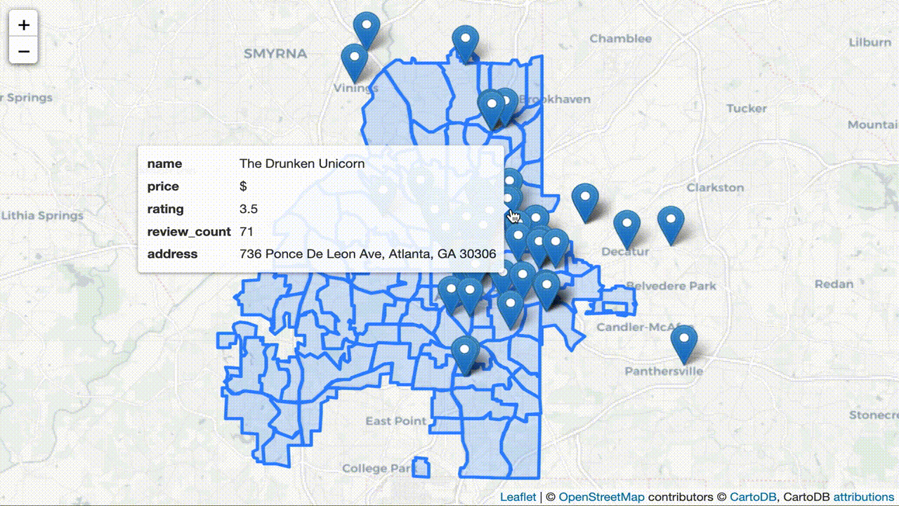
Competitor Analysis: Existing Music Venue
Main text – Navy Roboto 24px.
Example of a sub point. 18px Roboto
Subpoint example
Sub-sub point example the first
And the second

Slide 6
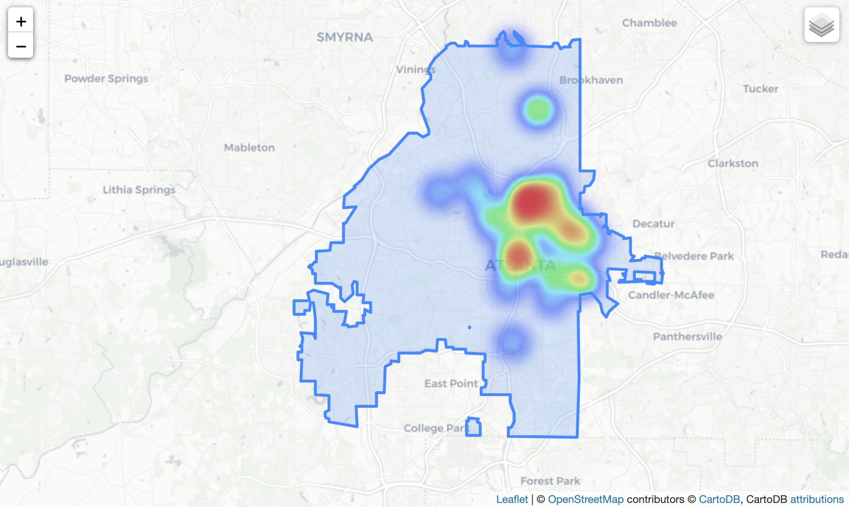
Competitor Analysis: Existing Music Venue
Main text – Navy Roboto 24px.
Example of a sub point. 18px Roboto
Subpoint example
Sub-sub point example the first
And the second

Slide 7
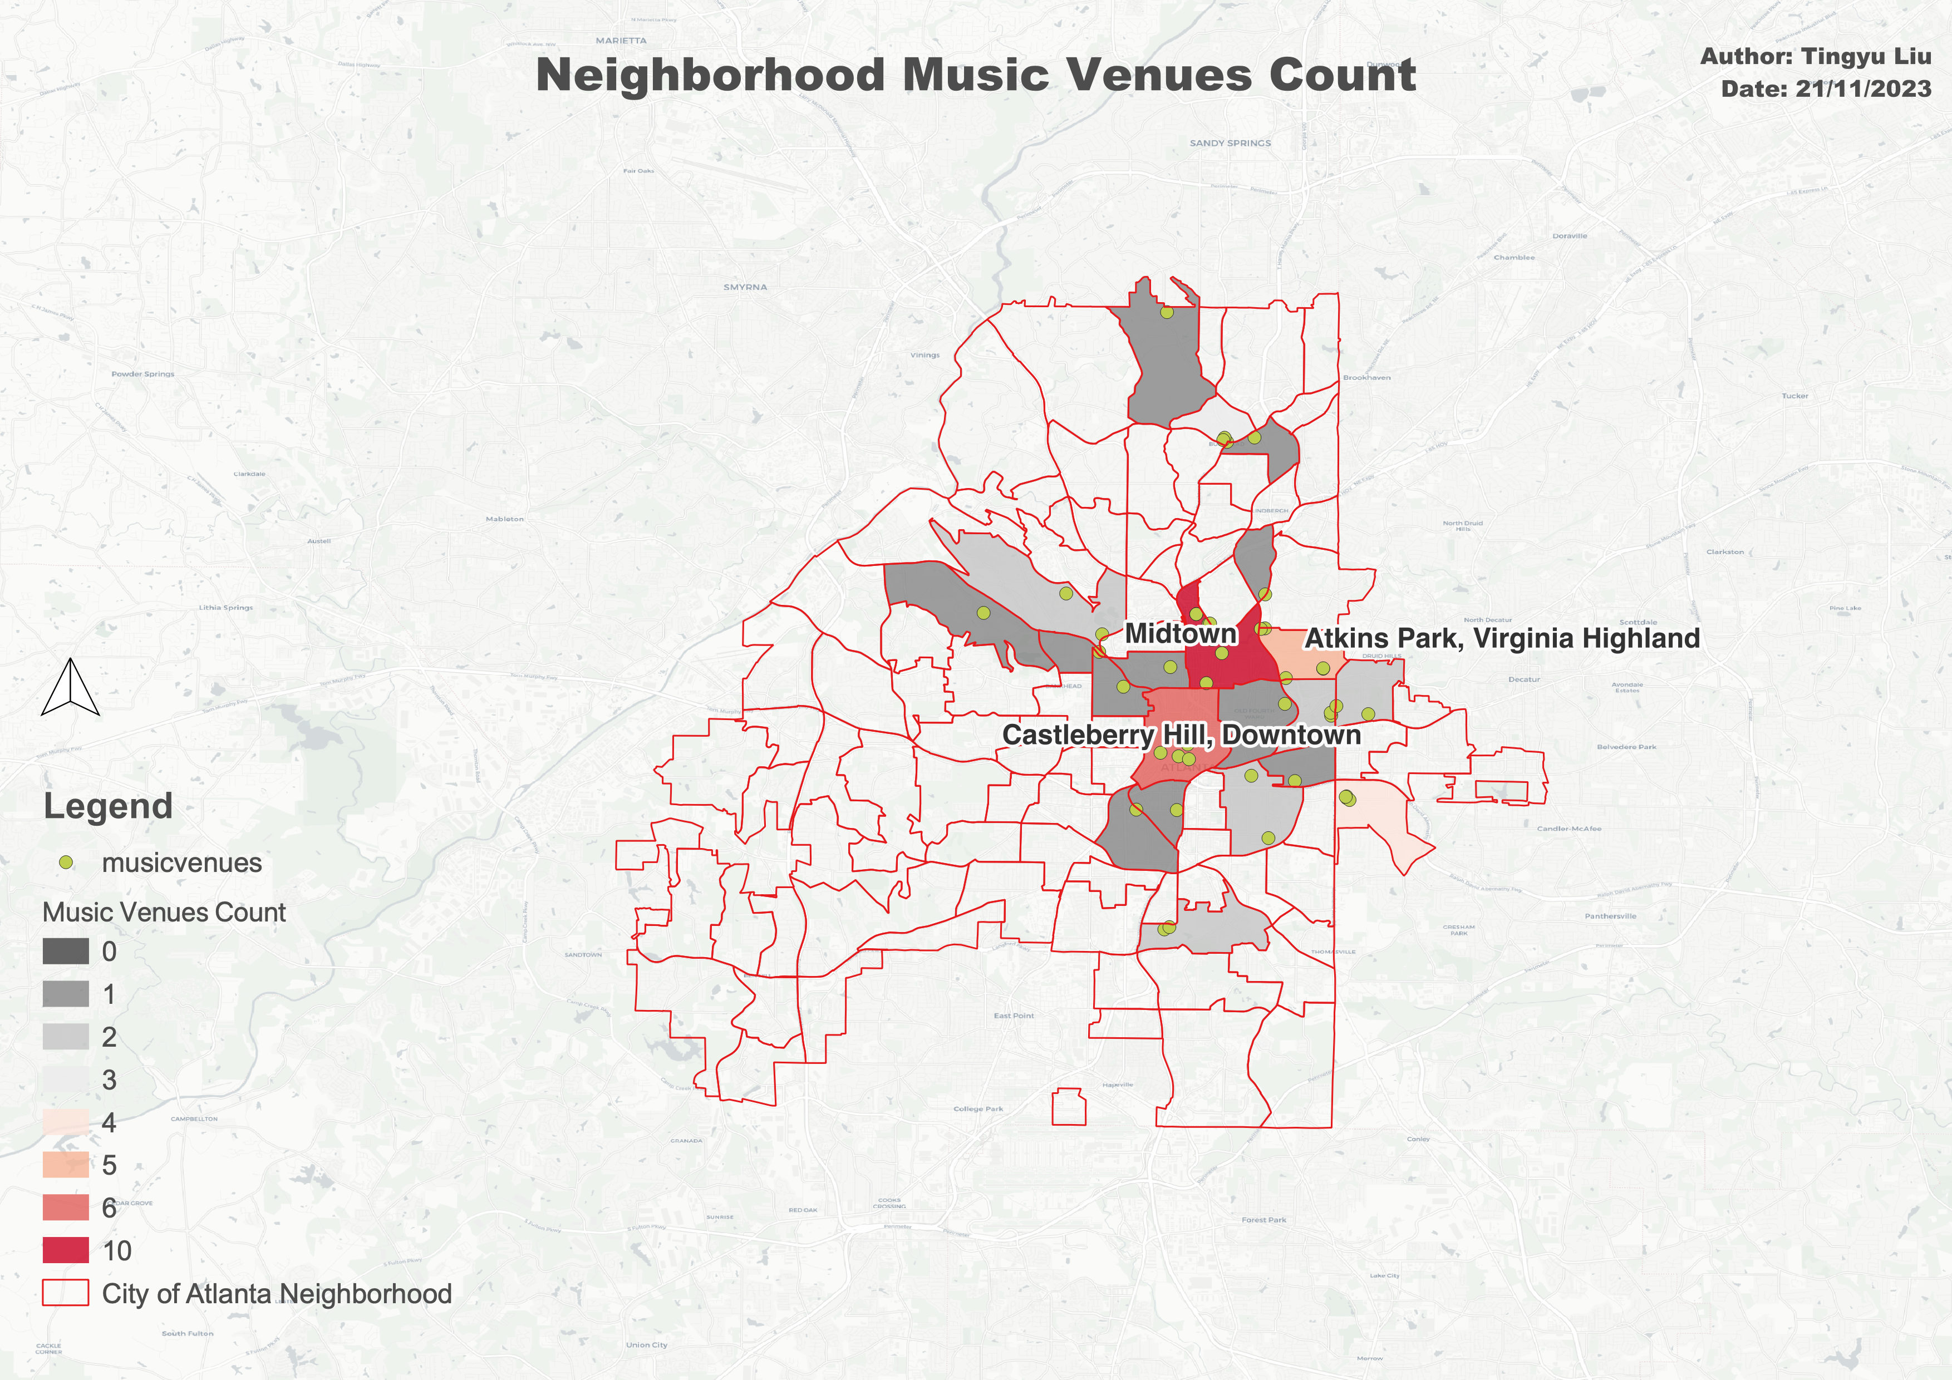
Competitor Analysis: Existing Music Venue
Main text – Navy Roboto 24px.
Example of a sub point. 18px Roboto
Subpoint example
Sub-sub point example the first
And the second

Slide 8
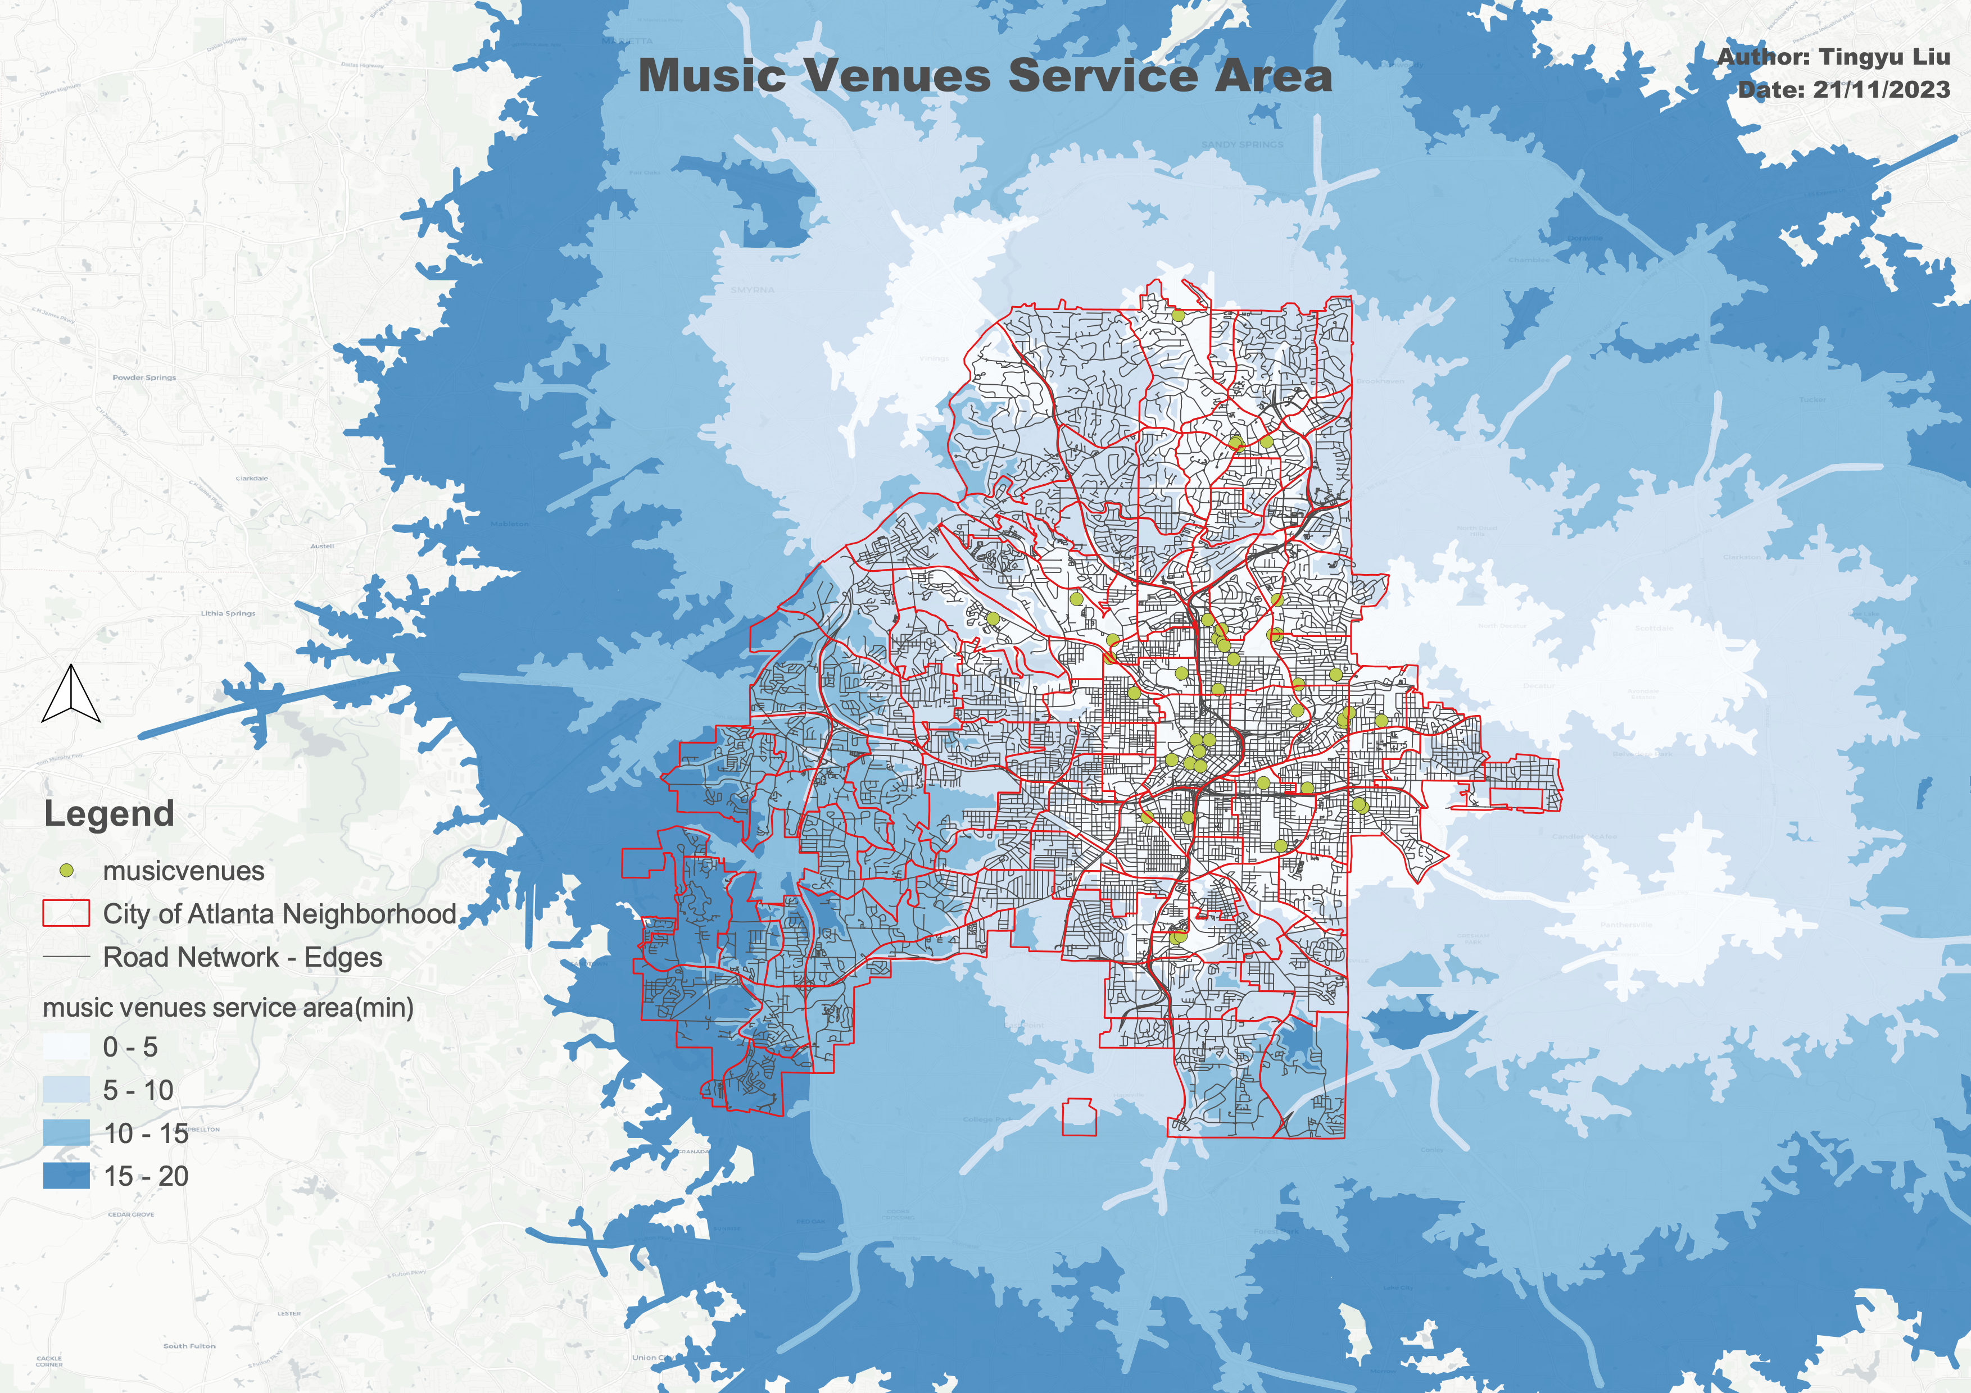
Transport Analysis: Existing Music Venue Service Area
Main text – Navy Roboto 24px.
Example of a sub point. 18px Roboto
Subpoint example
Sub-sub point example the first
And the second

Slide 9
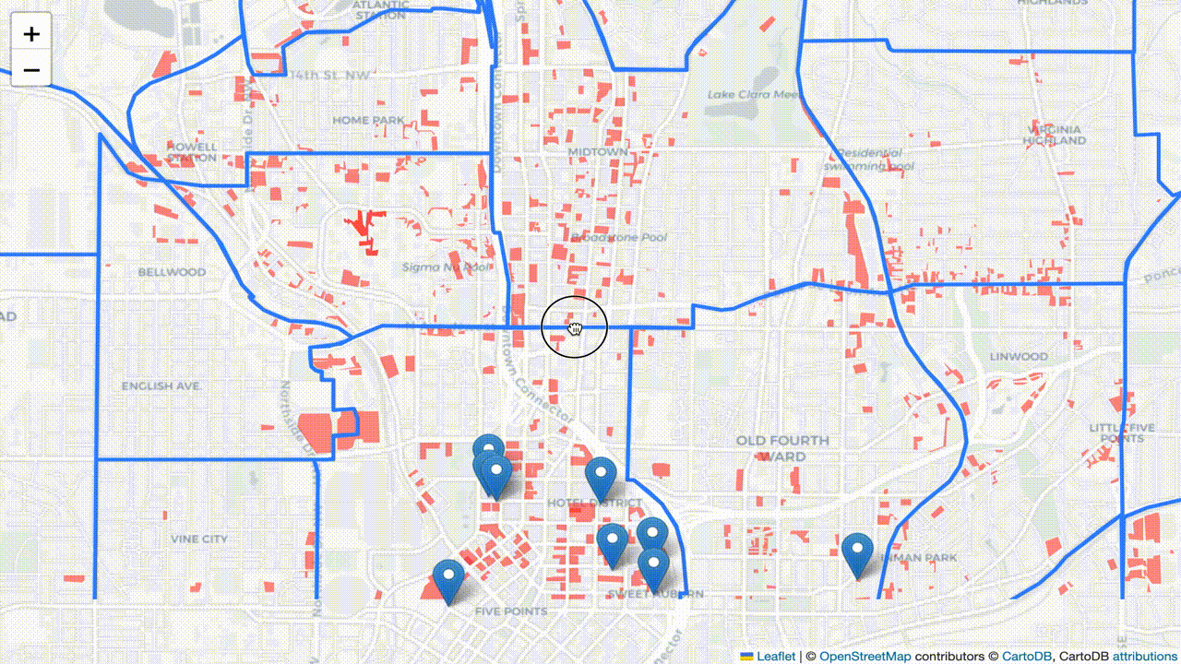
Transport Analysis: Parking Lots Distribution
Main text – Navy Roboto 24px.
Example of a sub point. 18px Roboto
Subpoint example
Sub-sub point example the first
And the second

Slide 10
Demographic Analysis – Who are metalheads?
Metalheads = People who go to metal music venues
- Largely white, cis-gendered, and male.
- Age: 33.49% 25-34, 25.17% 18-24, 35-44 19.54
- Most popular in North America and Northern Europe.
Notes:
The presentation should include your project objectives, the spatial or mathematical model that you built, analysis results, and findings. This will account for 15% of your final grade.

Slide 11
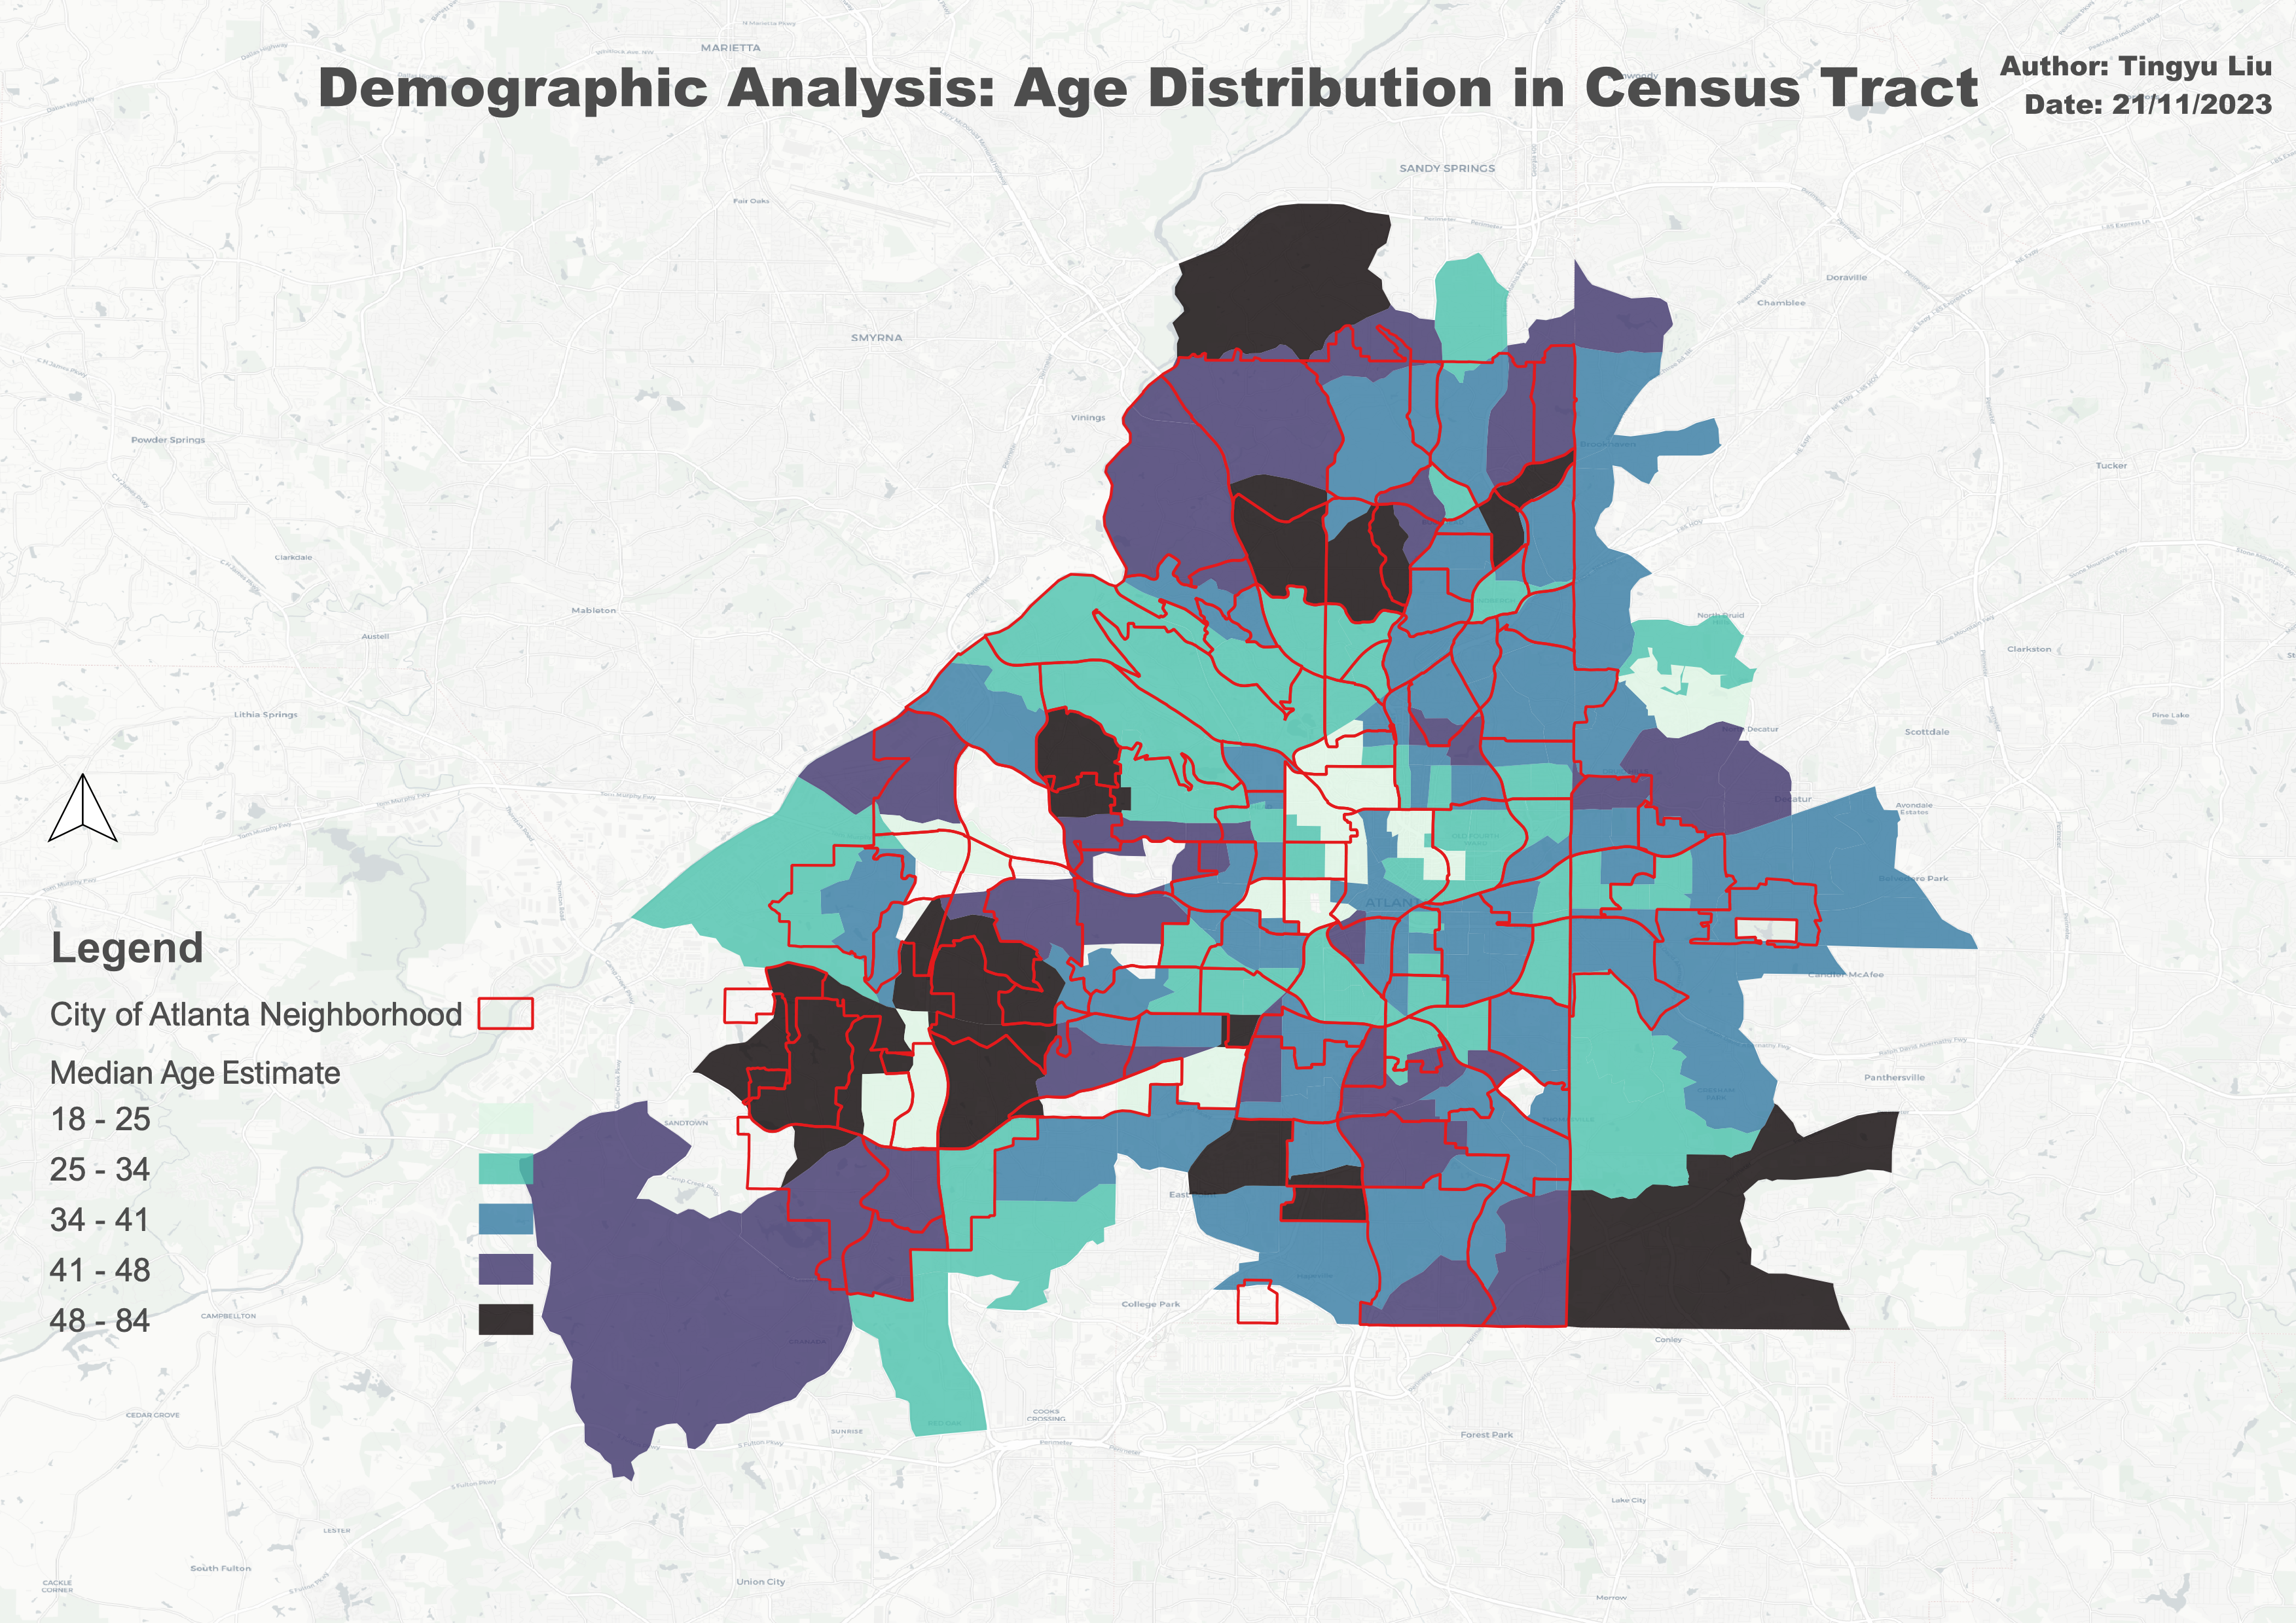
Demographic Analysis – Census Statistics

Slide 12
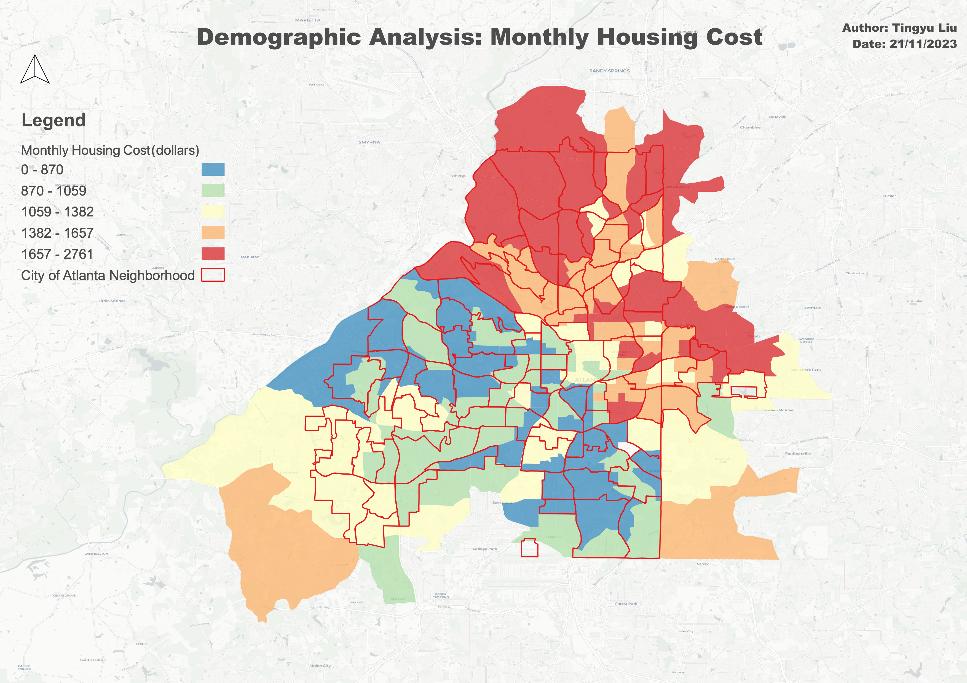
Demographic Analysis – Census Statistics

Slide 13
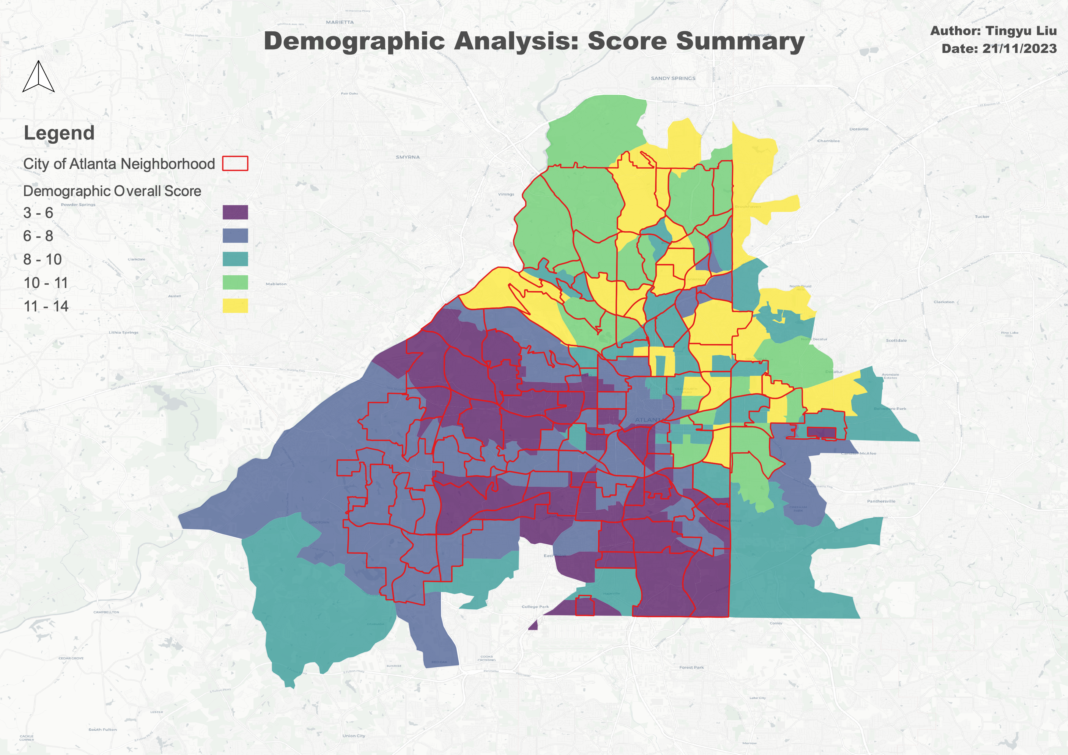
Demographic Analysis – Census Statistics

Slide 14
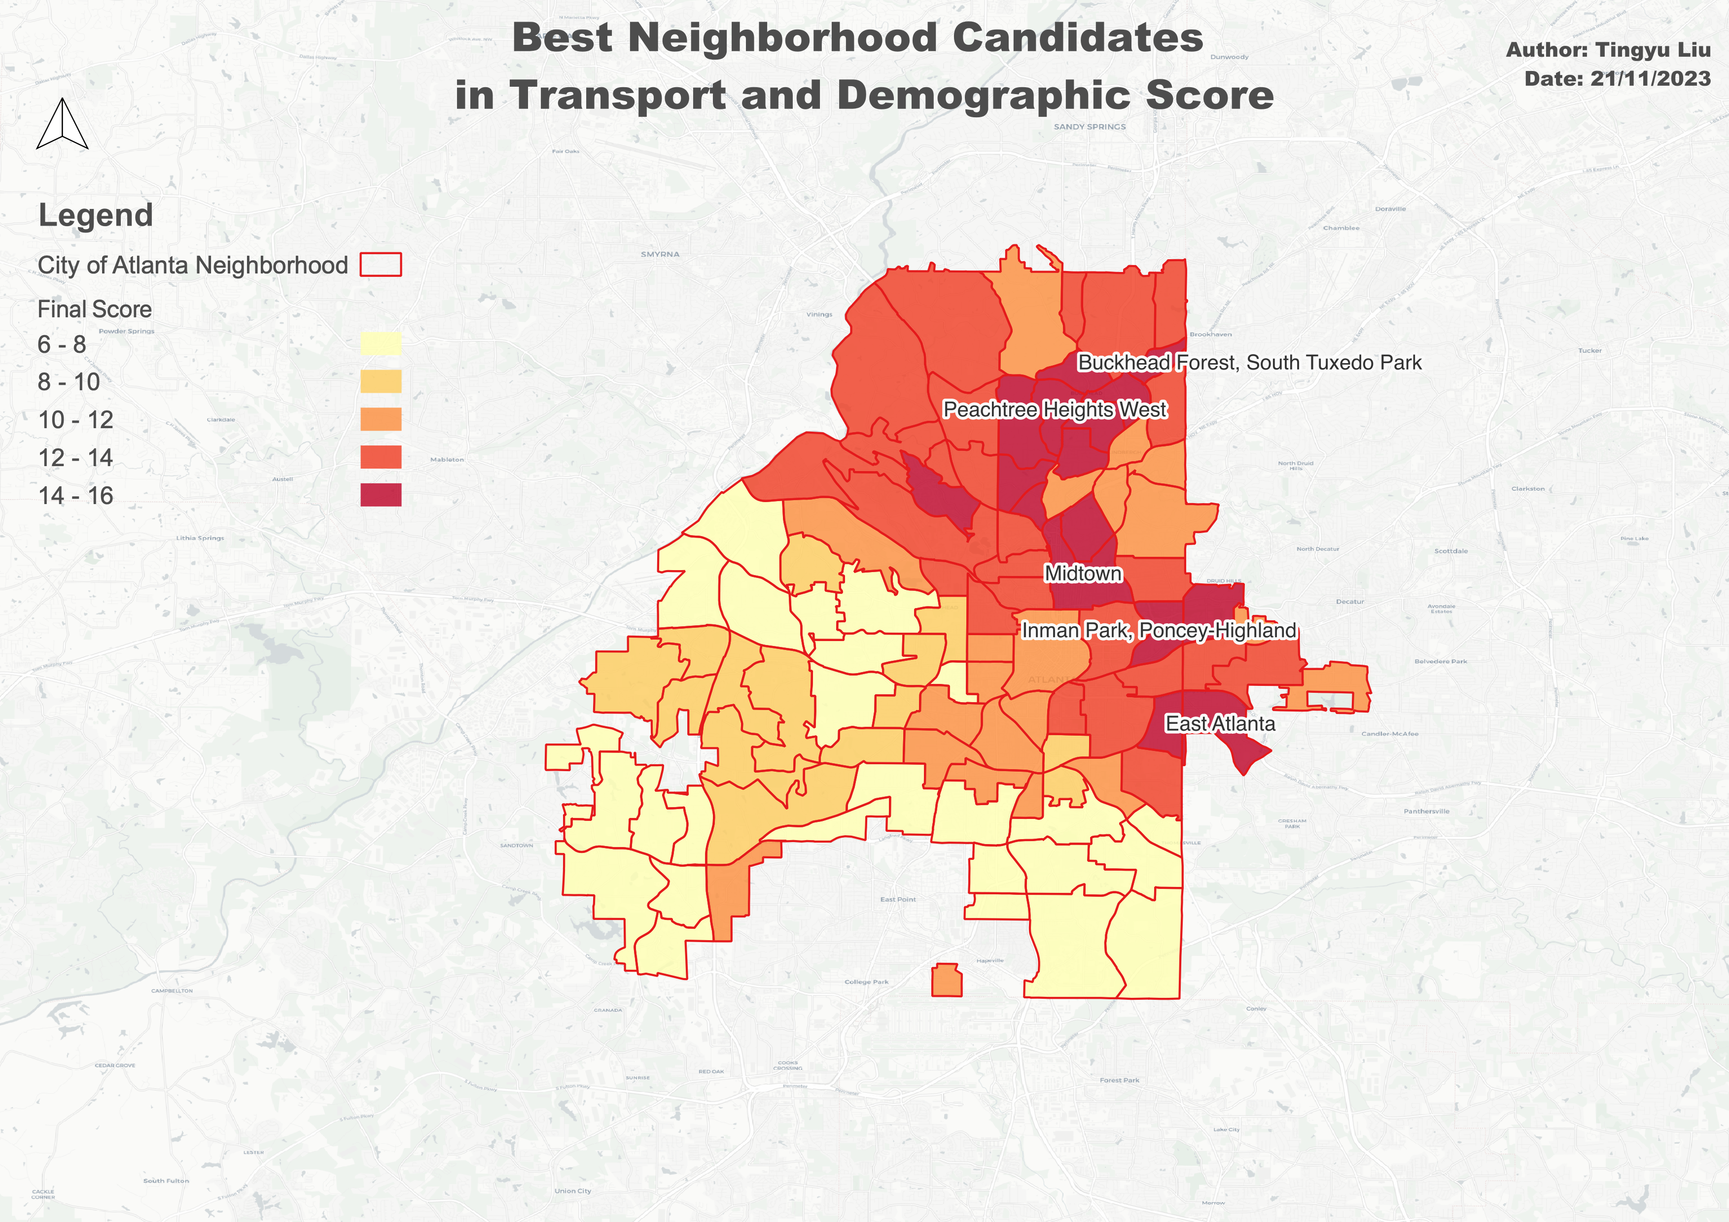
Integrate Transport and Demographic Factors
Main text – Navy Roboto 24px.
Example of a sub point. 18px Roboto
Subpoint example
Sub-sub point example the first
And the second

Slide 15
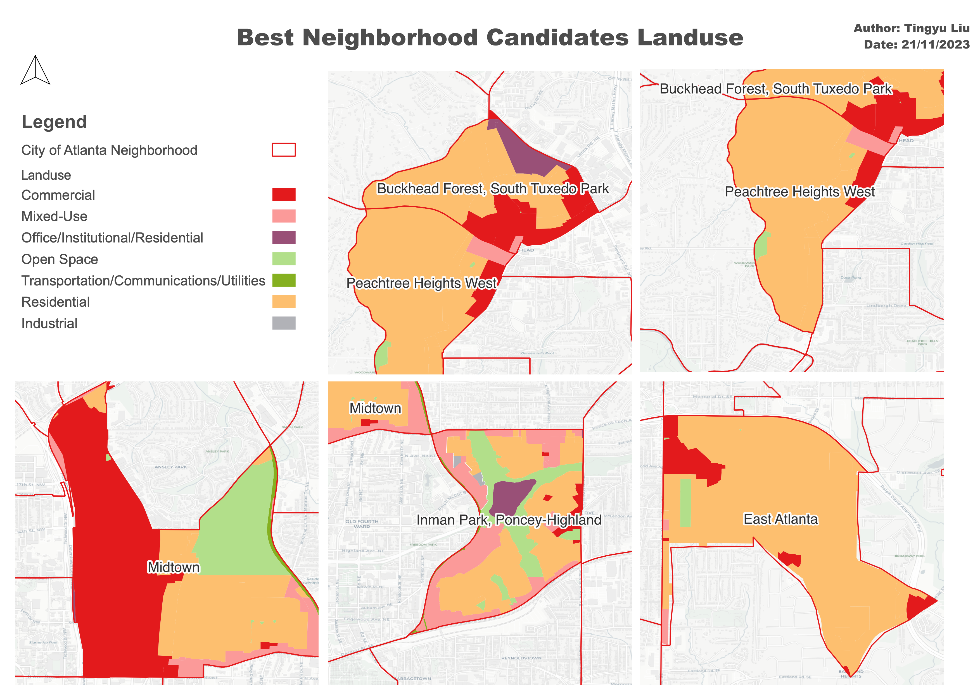
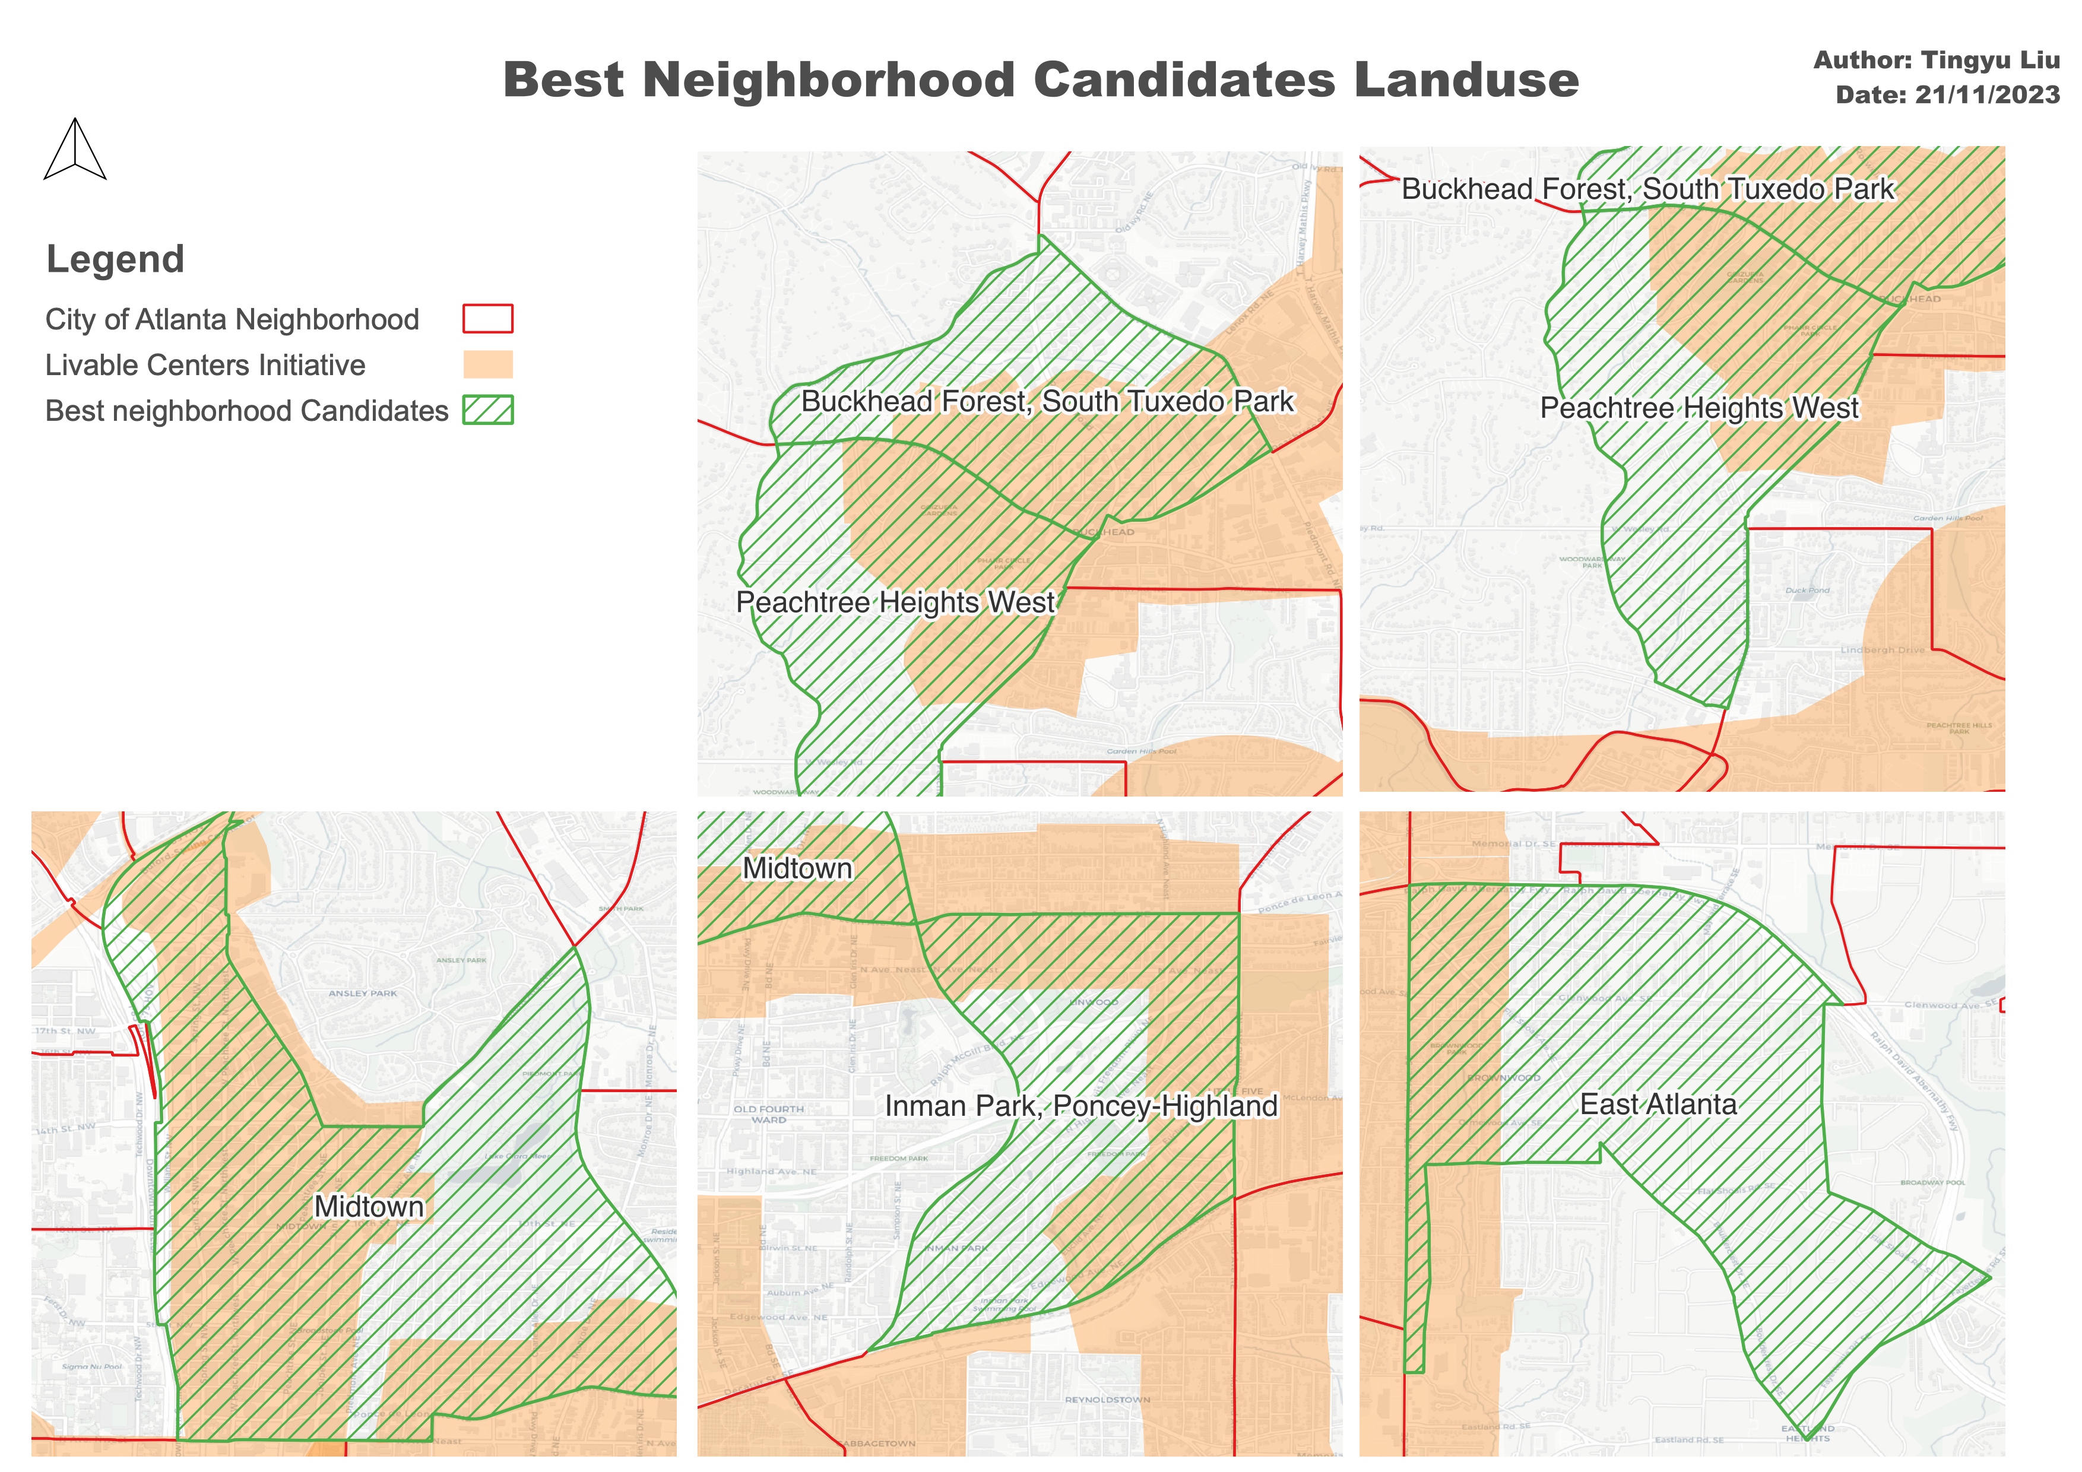
Restrictions: Zoning

Slide 16
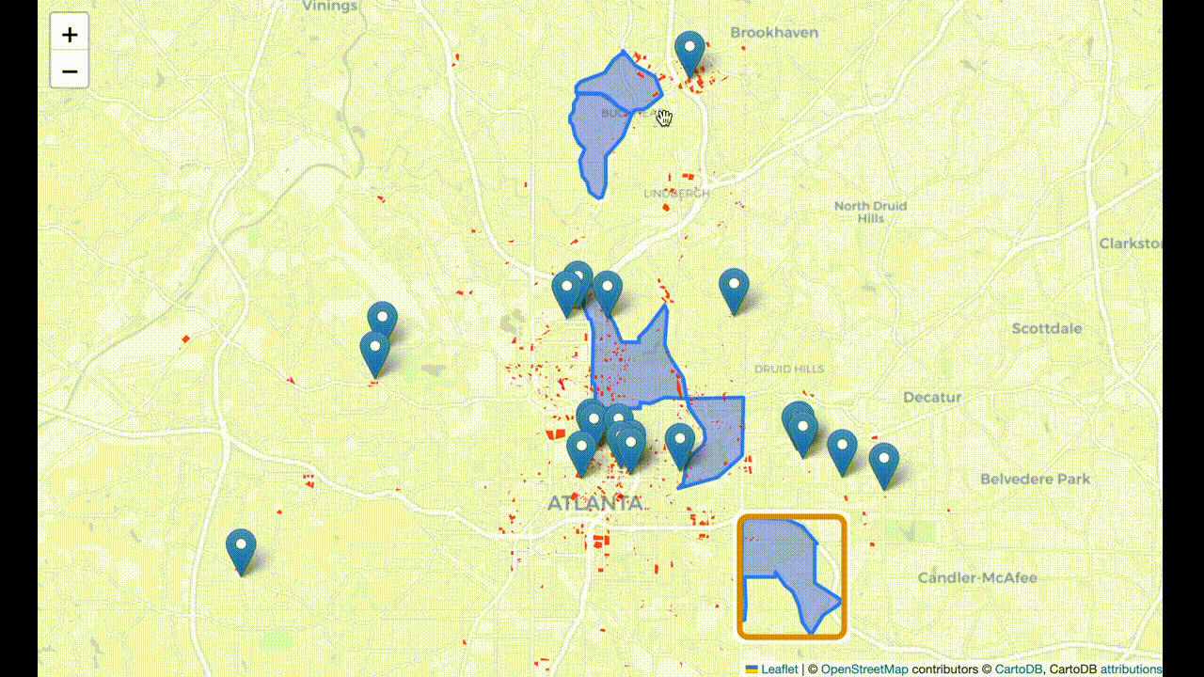
Restrictions: Parking

Slide 17
Integration and Final Selection
Midtown
In-man Park

Slide 18

Thank you Open to comments and suggestions!

